Slide 1
6
INFINITE SEQUENCES AND SERIES
Copyright © Cengage Learning. All rights reserved.

Slide 2
6.2
Series
Copyright © Cengage Learning. All rights reserved.

Slide 3

Series
What do we mean when express a number as a infinite decimal? For instance, we consider
The convention behind this decimal notation is that any number can be written as a infinite sum.
where the dots indicate that the sum continues forever, and the more terms we add, the closer we get to the actual value of .

Slide 4



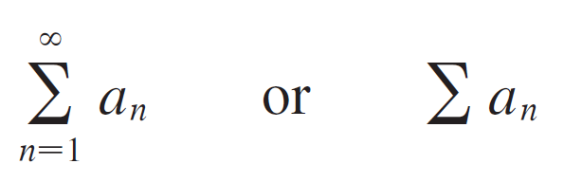
Series
If we try to add the terms of an infinite sequence we get an expression of the form
which is called an infinite series (or just a series) and is denoted, for short, by the symbol
Does it make sense to talk about the sum of infinitely many terms?

Slide 5
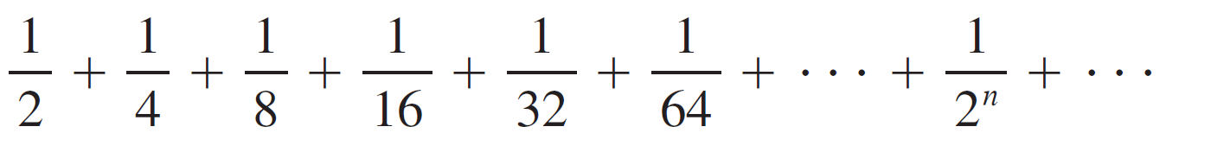

Series
If we start to add the terms of the series
we get

Slide 6
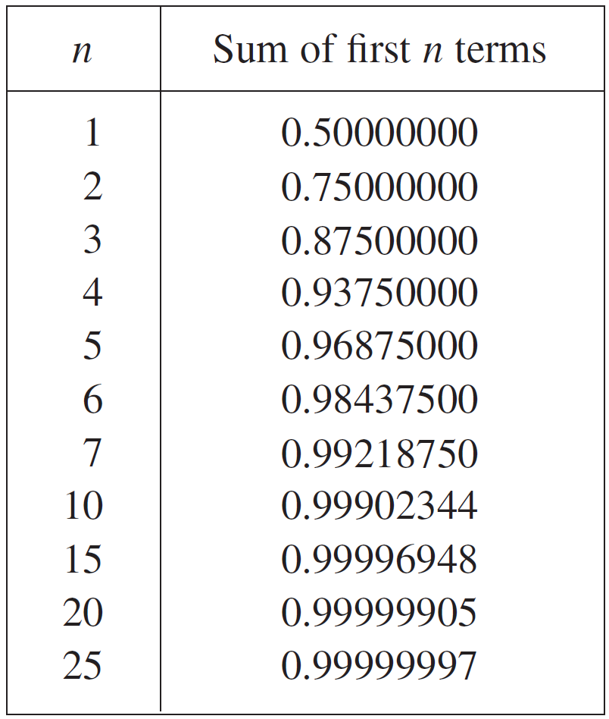
Series
The table shows that as we add more and more terms, these partial sums become closer and closer to 1.

Slide 7
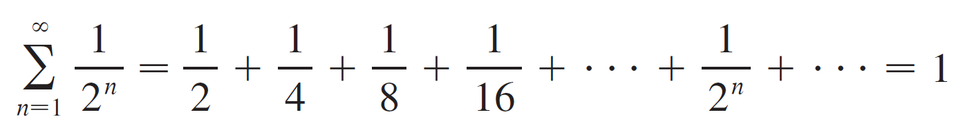
Series
In fact, by adding sufficiently many terms of the series we can make the partial sums as close as we like to 1.
So it seems reasonable to say that the sum of this infinite series is 1 and to write

Slide 8

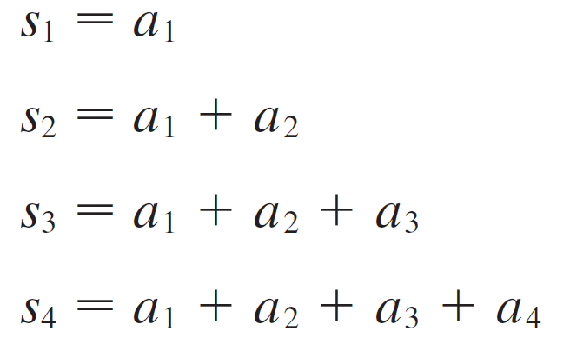
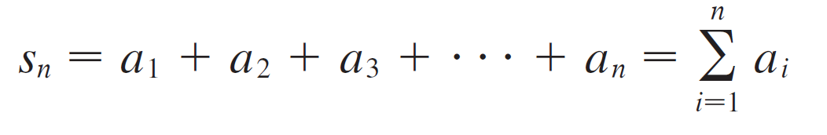
Series
We use a similar idea to determine whether or not a general series has a sum.
We consider the partial sums
and, in general,

Slide 9



Series
These partial sums form a new sequence which may or may not have a limit.
If exists (as a finite number), then, as in the preceding example, we call it the sum of the infinite series

Slide 10
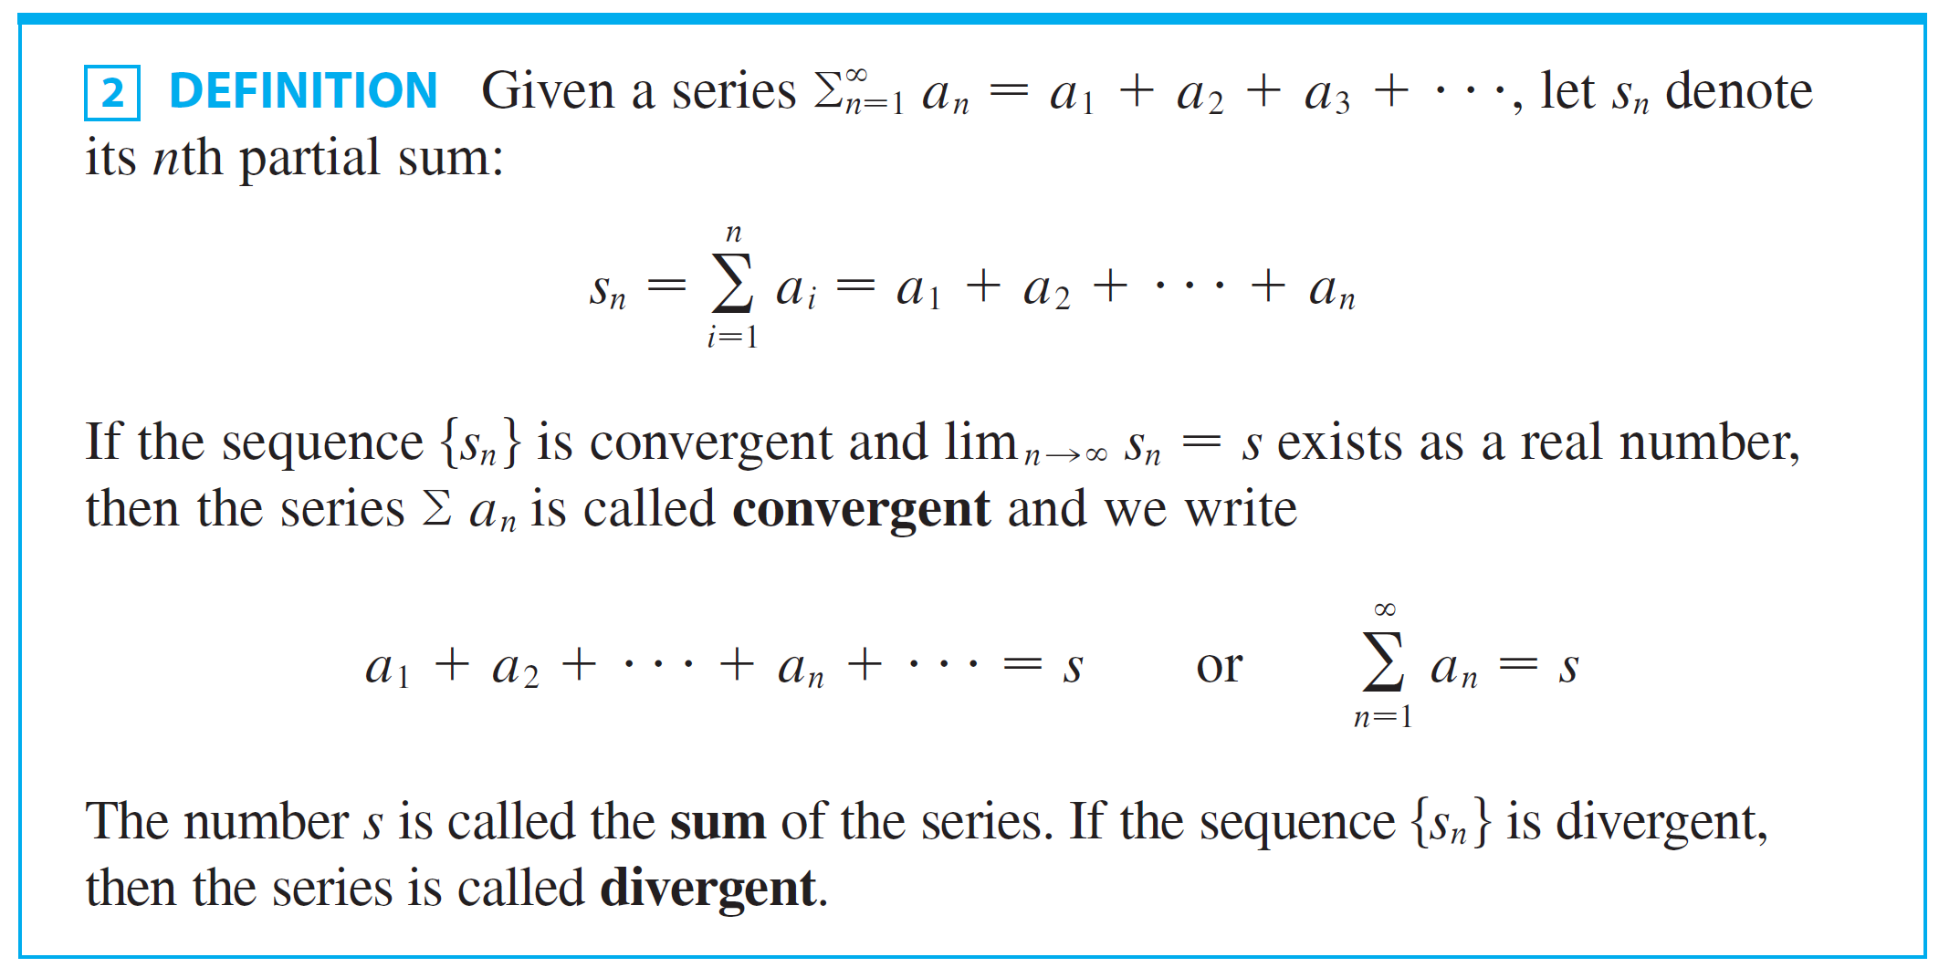
Series

Slide 11
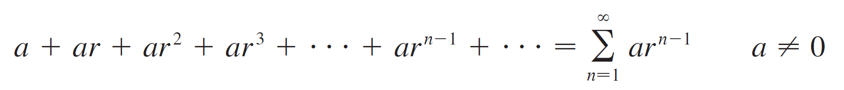

Example 1
An important example of an infinite series is the geometric series
Each term is obtained from the preceding one by multiplying it by the common ratio r.
If r = 1, then
Since doesn’t exist, the geometric series diverges in this case.

Slide 12
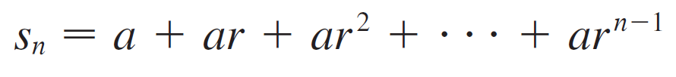

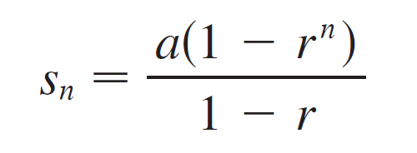

Example 1
cont’d
If r ≠ 1, we have
Subtracting these equations, we get

Slide 13

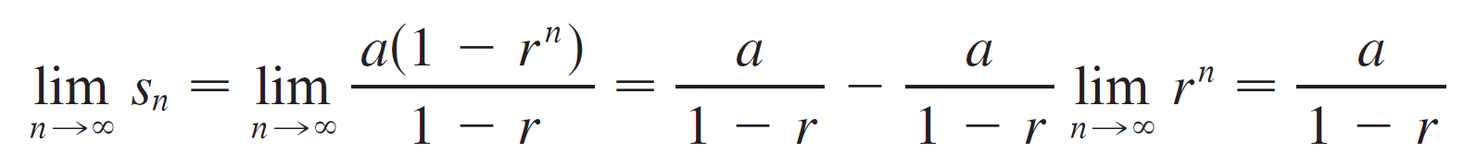

Example 1
cont’d
If –1 < r < 1, we know that , so
Thus when the geometric series is convergent and its sum is a/(1 – r).
If r ≤ –1 or r > 1, the sequence {r^{n}} is divergent and so, by Equation 3, does not exist.
Therefore the geometric series diverges in those cases.

Slide 14
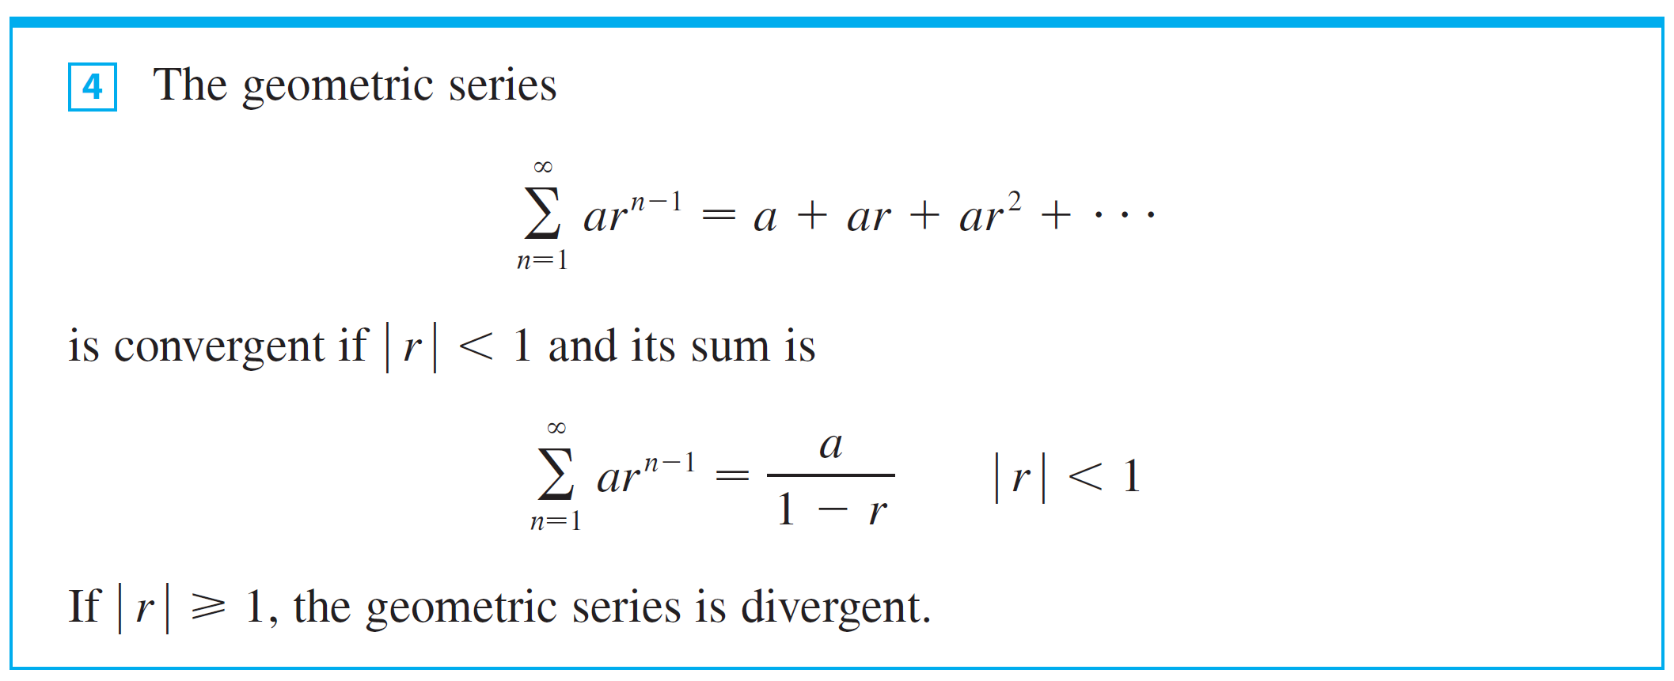
Series
We summarize the results of Example 1 as follows.

Slide 15
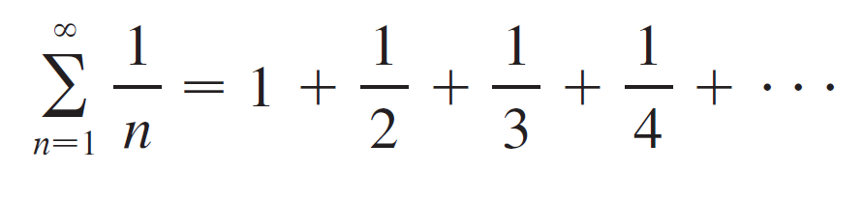

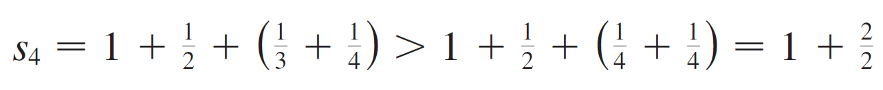
Example 7
Show that the harmonic series is divergent.
Solution:
For this particular series it’s convenient to consider the partial sums s₂, s₄, s₈, s₁₆, s₃₂, … and show that they become large.

Slide 16
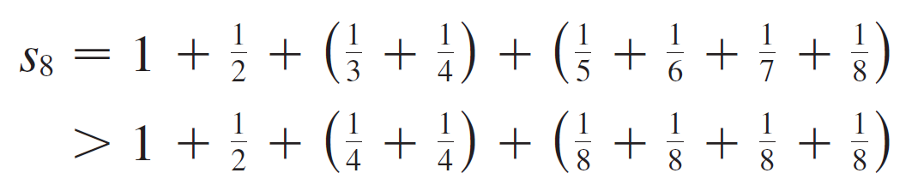
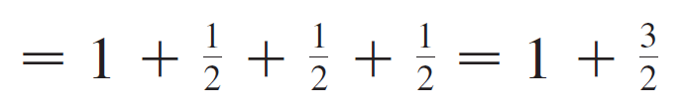
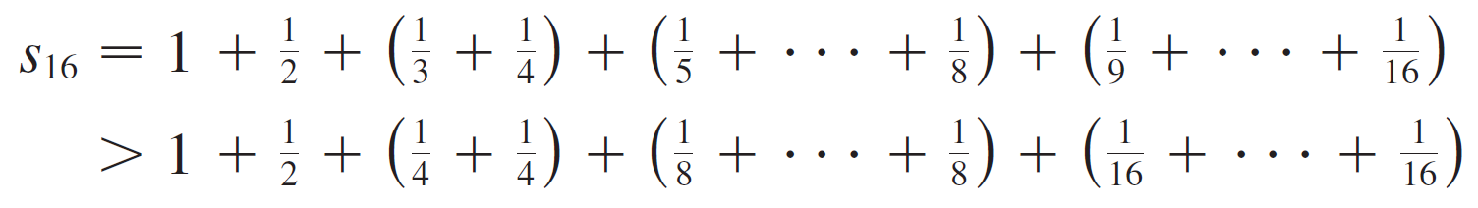
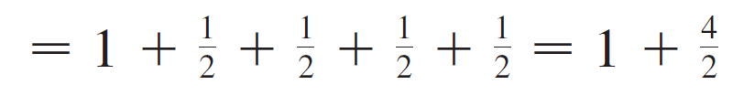
Example 7 – Solution
cont’d

Slide 17

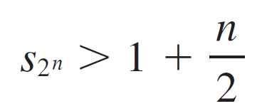


Example 7 – Solution
cont’d
Similarly, and in general
This shows that and so is divergent. Therefore the harmonic series diverges.

Slide 18




Series
The converse of Theorem 6 is not true. (e.g. harmonic series)
With any series we associate two sequences: the sequence of its partial sums and the sequence
of its terms.
If is convergent, then the limit of the sequence
is s (the sum of the series) and, as Theorem 6 asserts, the limit of the sequence is 0.

Slide 19
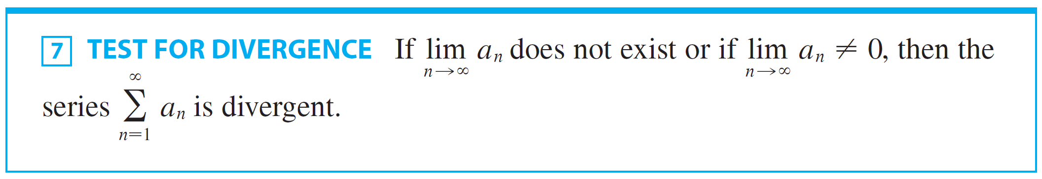

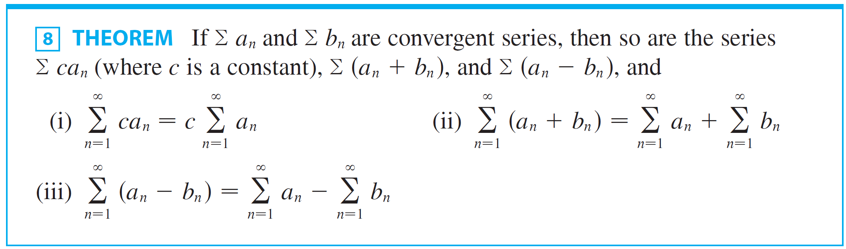
Series
If =0, we know nothing about the convergence or divergence.

Slide 20
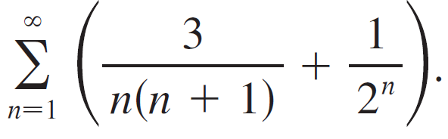

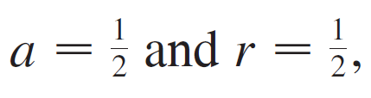
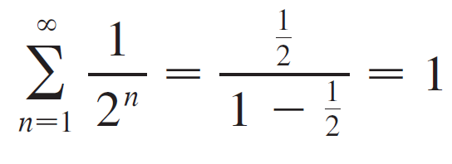
Example 9
Find the sum of the series
Solution:
The series is a geometric series with
so

Slide 21
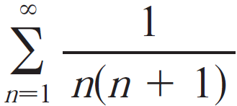
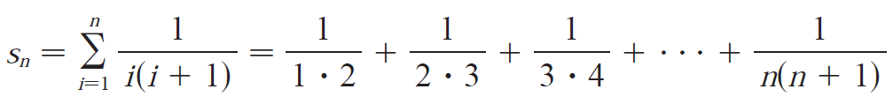
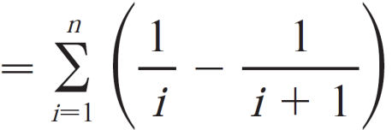
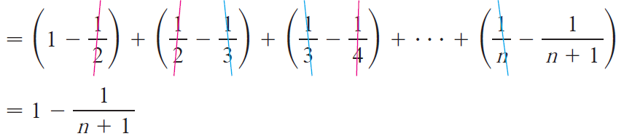
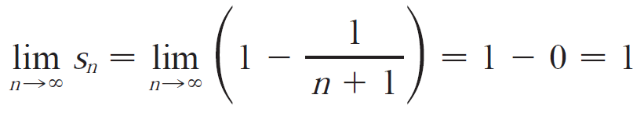
Example 9 – Solution
cont’d
We will calculate the series by definition.
The partial sum is
So,

Slide 22
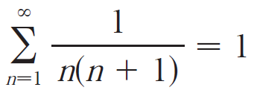
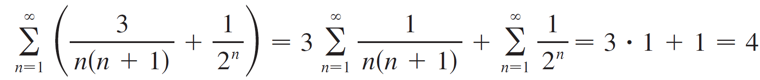
Example 9 – Solution
cont’d
We have the series is convergent and
So, by Theorem 8, the given series is convergent and

Slide 23
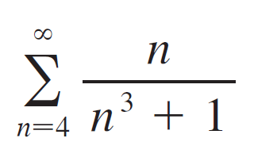
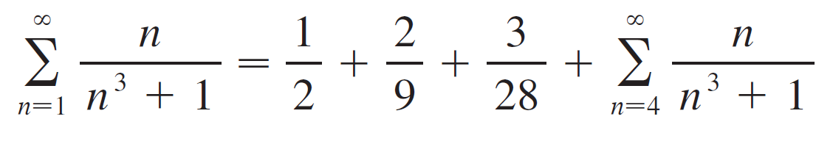
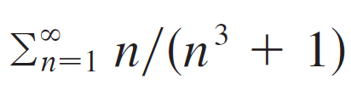
Series
A finite number of terms doesn’t affect the convergence or divergence of a series. For instance, suppose that we were able to show that the series
is convergent. Since
it follows that the entire series is convergent.

Slide 24

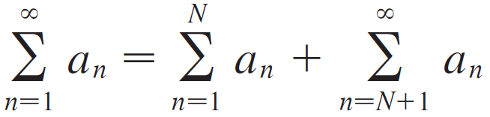
Series
Similarly, if it is known that the series converges, then the full series
is also convergent.

